Slide 1

Ayush Herbal Garden (TEAM METAVERSE)
- TEAM MEMBERS
Shruti More
Saniya Gurav
Aaryaa Khandwani
Vinayak Vathare

Slide 2
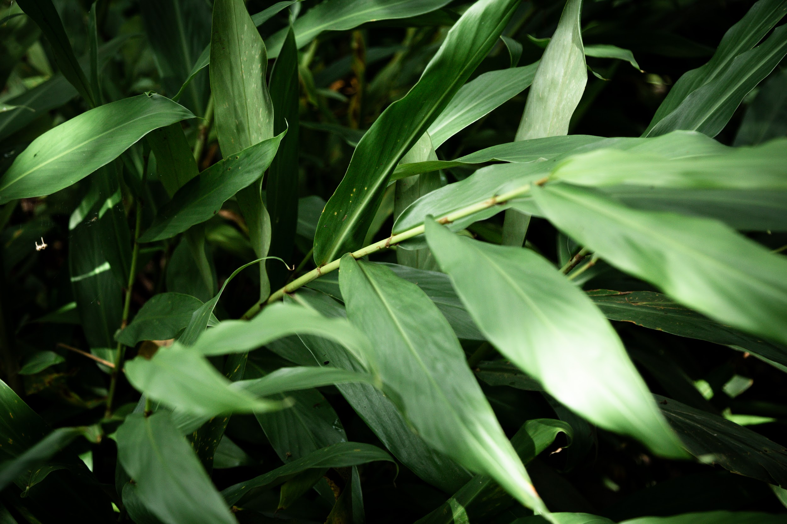
INTRODUCTION
The Virtual Herbal Garden integrates advanced features to create an immersive experience. It offers detailed information and 3D models of medicinal plants, alongside an Virtual Reality (VR) module that allows users to interact with plants virtually. Additionally, Gamification features like "Find the Plant" and "Guess the Plant" make learning engaging. The personalized user flow guides visitors through rare and popular AYUSH plants, while a machine learning-powered image recognition tool helps identify plants through simple uploads. The intuitive design ensures accessibility for a wide range of users, from students to practitioners.

Slide 3
Proposed Solution
Allows users to virtually walk through and explore the garden with MR integration and interactive 3D views.
Provides detailed information on each plant, including botanical names, medicinal uses, cultivation methods, and its significance in traditional medicine.
Offers a lifelike and structured learning experience for students and enthusiasts.
Enhances engagement with high-quality images, videos, and guided virtual tours of medicinal plants.
Aims to make learning about AYUSH medicinal plants more accessible, engaging, and educational.

Slide 4

FEATURES
Interactive 3D Models
Detailed Plant Information
Guided Virtual Tours
Search & Filter Tools
Gamification
Plant Recognization

Slide 5
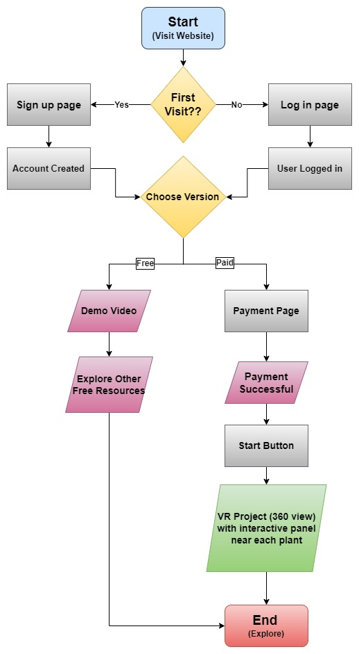
TECHNICAL APPROACH
FLOWCHART
TECHSTACK
Web-Development: HTML, CSS, Java Script, React.js
VR : Unity , Blender
Design :- Canva, Figma, Adobe Express
Framework: Node.js, WebGL, Three.js, AR.js, C#
Database: MySQL, Google Cloud
Version Control: GitHub, Docker, Kubernetes
IMPLIMENTATION
PROTOTYPE : https://ayush-medicine.vercel.app/
ILLUSTRATION: https://youtu.be/kYRVvQKA99A?si=PPAoBooPCGC9Nw7Q

Slide 6
IMPACTS AND BENEFITS
IMPACTS
BENEFITS
Enhanced Awareness
Visual Engagement
Multimedia Learning
Traditional Medicine Insight
Biodiversity Protection
Comprehensive Learning Tool
Interactive Features
Cultural Heritage Preservation
Accessible Education
Practical Application

Slide 7
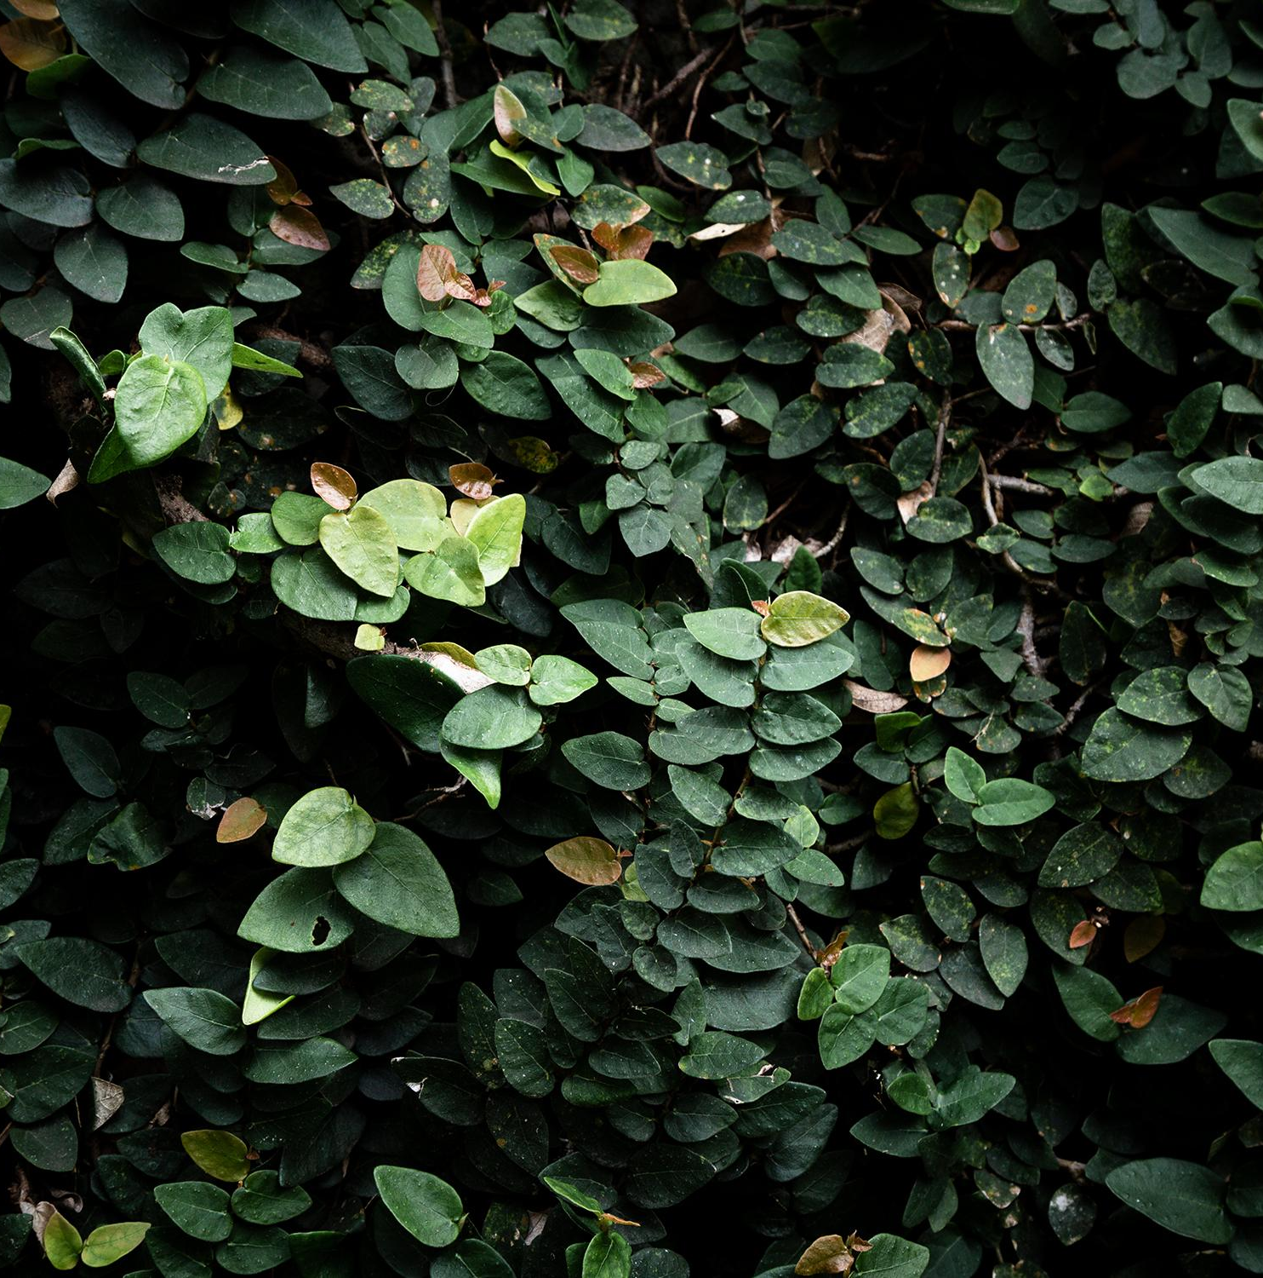
Future Enhancement
Metaverse
Mobile App Integration
AI-based Plant Recommendations
Meditation
Zones

Slide 8
CONCLUSION
The Virtual Herbal Garden successfully bridges the gap between traditional knowledge and modern technology, offering a comprehensive platform for exploring AYUSH medicinal plants. With its immersive 3D models, AR interaction, and gamified learning, it enhances user engagement while making herbal knowledge accessible to a global audience. The inclusion of advanced features like machine learning-based plant recognition and an intuitive design ensures a seamless and enriching experience for both students and practitioners. This project not only promotes awareness of traditional healing practices but also provides a valuable educational tool that combines the best of both worlds.

Slide 9
REFERANCES AND RESEARCH
Herbal Gardens for Health and Wealth S. RAMESH KUMAR
Department of Horticulture, Kumaraguru Institute of Agriculture, Sakthinagar-638 315,Erode Agriculture Research
Journal. District, Tamil Nadu, India. Current.
Virtual garden: Development and student's perceptions
Article in Journal of Technology and Science Education , January 2023 DOI: 10.3926/jotse.152
Analysing augmented reality (AR) and virtual reality (VR) recent development in education
a) Faculty of Education, Thamar University, Thamar, Yemen
b) Dhofar University, Salalah, Sultanate of Oman
c) Faculty of Economic and Business, Universitas Muhammadiyah Yogyakarta, Yogyakarta, Indonesia Faculty of Info-communication Networks and Systems.

Slide 10
THANK YOU
- Team MetaVerse

